Slide 1
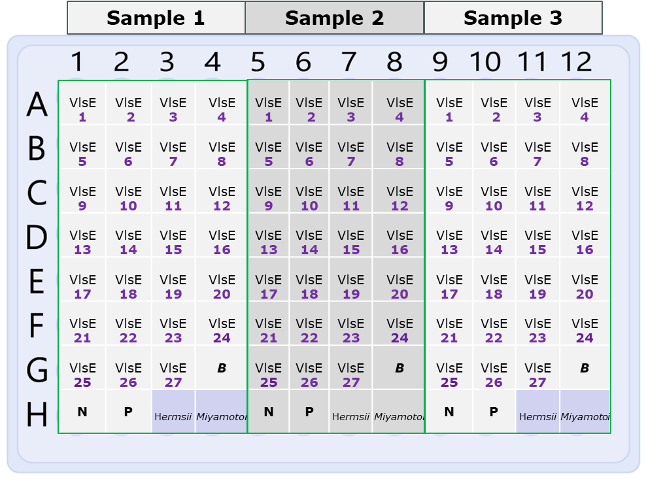
Epitogen Lyme VlsE IgM Assay
Epitogen® Lyme VlsE IgM Assay: Redefining Lyme Disease Research
VlsE is a surface lipoprotein in Borrelia burgdorferi that undergoes antigenic variation through segmental recombination with silent cassettes. This process allows the bacterium to evade immune detection and persist in the host, creating significant variability in VlsE among different Borrelia species—posing a major challenge for research and diagnostics.
Using our proprietary Epitogen® technology, we successfully expressed 27 full-length VlsE variants representing key pathogenic species: B. burgdorferi sensu stricto, B. afzelii, B. garinii, B. mayonii, B. spielmanii, B. bissetiae, B. bavariensis, and B. valaisiana.
This expansive VlsE antigen panel is designed to advance Borrelia research, improve strain-specific diagnostics, and support accurate epidemiological tracking. Powered by our unique Epitogen® scaffold, it ensures precise antigen orientation for reliable comparison and high assay performance.
Intended Use:
The assay is designed for use in two key scenarios:
a) Strain Identification in Confirmed Lyme Disease Cases:
It provides additional insight into the specific Borrelia strain responsible for infection in patients who have already tested positive for Lyme disease. This information can support epidemiological tracking, inform treatment decisions, and enhance our understanding of regional strain prevalence.
b) Re-evaluation of Serology-Negative but Clinically Suspected Lyme Cases:
In patients presenting with clinical symptoms consistent with Lyme disease but who test negative on standard serological assays, this test offers an additional diagnostic tool. It may detect immune responses to less commonly targeted Borrelia species or variants, potentially improving diagnostic sensitivity and supporting earlier intervention.
Complementary Use with the Lyme VlsE IgG Assay:
When used in combination with the Lyme VlsE IgG Assay, this test provides deeper insights into the infection stage and immune system profile—offering enhanced diagnostic clarity and greater confidence in clinical decision-making.
Antigen coating
Differential VlsE Layout
1-27 VlsE Borrelia variants.
B
Empty well.
N
Scaffold control.
P
Lyme antigen.
Borrelia Hermssi antigens
Borrelia miyamotoi antigens
Test Sample (3 samples/plate) – apply Lyme positive sample.
Note: VlsE identifiers and their corresponding species of origin will be provided in the technical manual.

